Slide 1

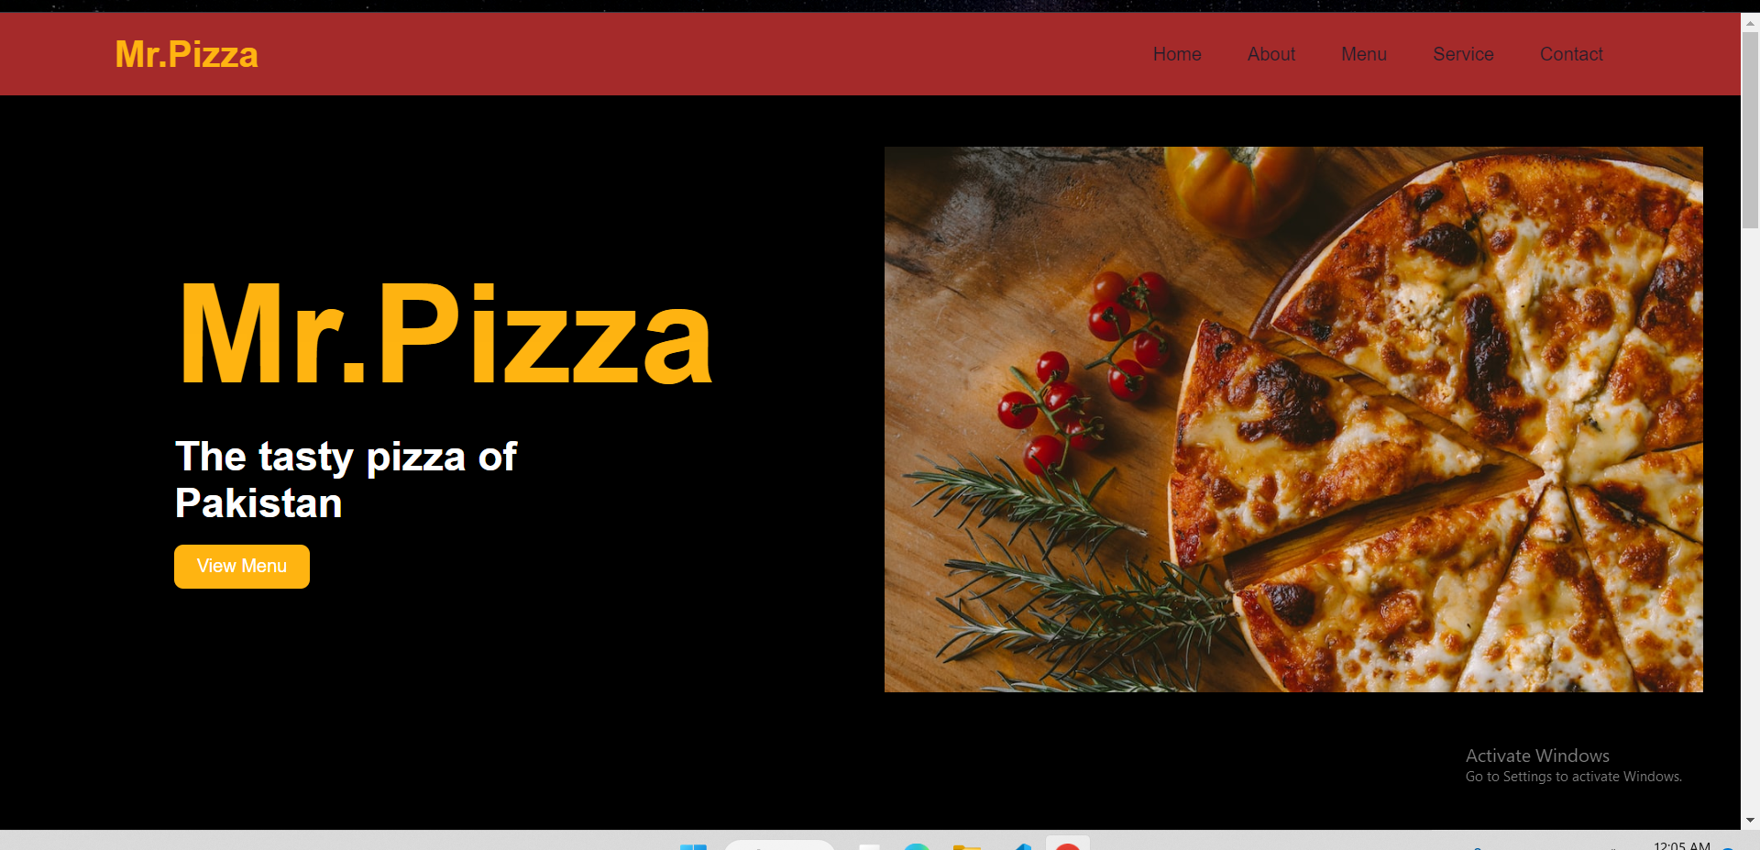
Muhammad Kafeel Jamil 201939221
Pizza Shop

Slide 2
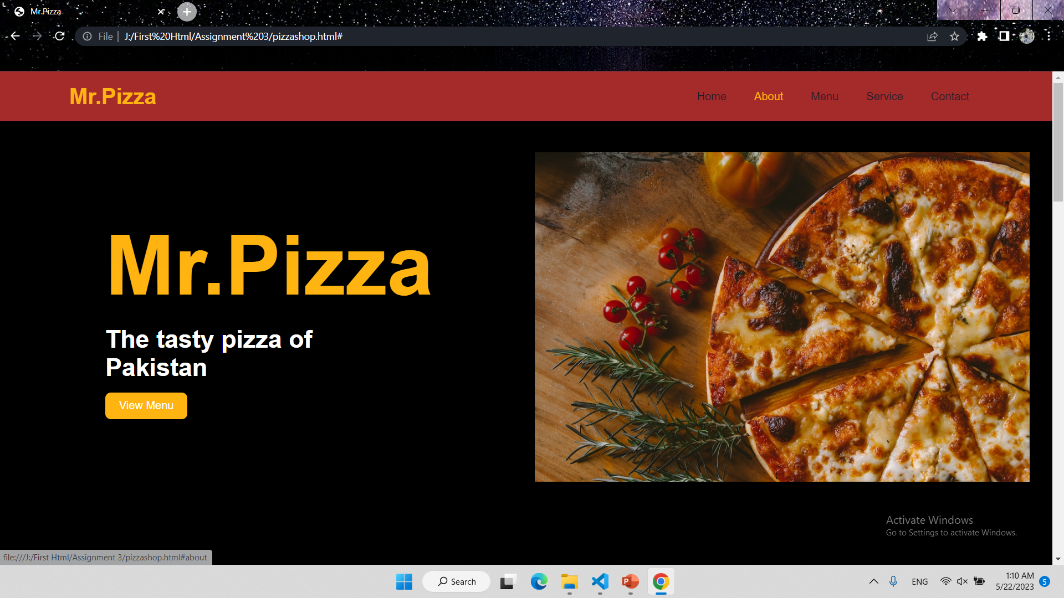
Header & Naver menu Hovering and Scrolling

Slide 3
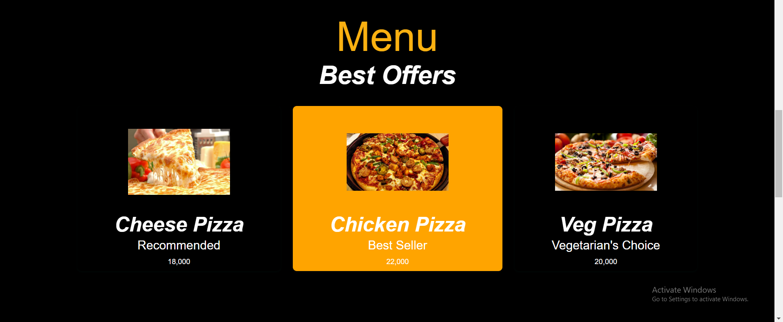




Menu Hovering with pointer

Slide 4
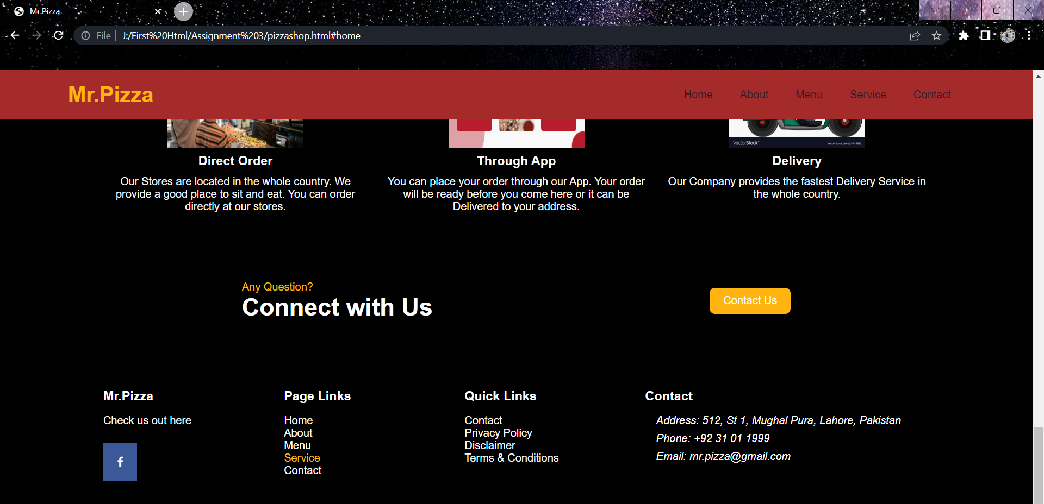
Page links scroll to the pages

Slide 5
Social Media Logo and link is added.

